Slide 1


Session 12. Introduction to Process Workflow
T24 Technical Induction Training
Minsk, 2021

Slide 2




Agenda
Process Workflow Overview
PW Components
PW Glossary
PW Deal Processing
PW Patterns
PW Variables
PW Enquiries

Slide 3

Process Workflow Overview
T24 Process Workflow is aimed at grouping various businesses and banking procedures into a logical process of activities. This grouping enables allocation of work to different users, ensuring vital tasks are not left out causing a breakdown or delay in the process chain
Individual activities are defined at micro level: defining rules, statuses and user groups, which can all be re-used. These activities are then set out in a pre-defined sequence allowing a customized business processes to be followed
Process Workflow module does not in itself carry business functionality but can be used to define and tune the flow of business supported by other T24 modules. It can be seen as a way of linking together T24 applications, providing automatic mapping and directing of tasks to appropriate task members and groups

Slide 4
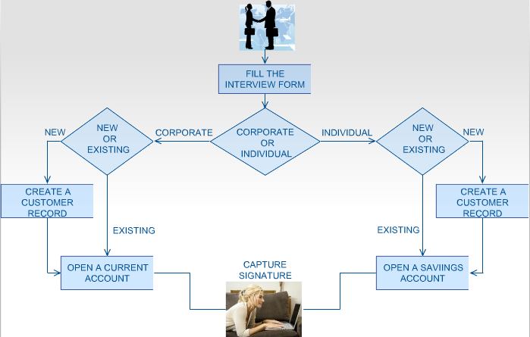
Process Workflow Overview
For example, Mr. Brown who is currently not a customer of the bank, walks in and wants to open an account. Does he go straight to the account opening desk? The bank has a process defined for circumstances like this:

Slide 5
Process Workflow Components
The majority of module components in Process Workflow are directly involved in the creation and management of processes themselves. As such, while each component can be used in multiple processes, they are not themselves system-wide components. These components are assembled together to form activities, which themselves are assembled to create processes
The sole system wide component is PW.PARAMETER which is used to handle the automatic archiving of completed processes
Process-specific components:
PW.STATUS
PW.TRANSITION
PW.VERB and PW.ACTIVITY.OBJECT
PW.PARTICIPANT

Slide 6
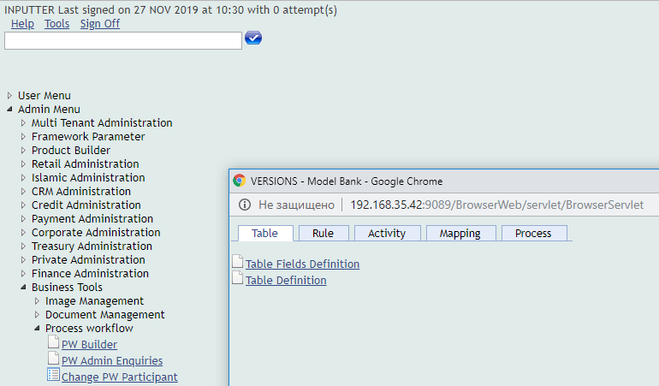
Process Workflow Components
Data Mapping:
EB.MAPPING.SOURCE
EB.FORMAT.ENTRY
Tables for bringing together the components to create the processes:
PW.ACTIVITY
PW.PROCESS.DEFINITION

Slide 7
Process Workflow Glossary - ACTIVITY
Activity is a single step within a process
An activity represents an item of work, which is allocated to a person and/or a team. It may be triggered by any other step within the process (or may be the first step in the process). In turn it can trigger one or more further steps in the process
An activity is always linked to a single record within T24 (note, the same record may be used in different activities – for example, when a customer record is returned to later in a process to add extra data)

Slide 8
Process Workflow Glossary - ACTIVITY
An activity is always in a particular status (any number of statuses can be defined in T24). Depending on this status, it may be considered ‘open’ (activity may be revisited, status may change) or ‘closed’ (activity is complete, no further change may occur). Depending on the status of this activity, further activities, or even new processes, may be launched – or the overall process could be closed. The status of an activity is determined by a RULE
An activity may be ‘auto’ or ‘manual’. An ‘auto’ activity can be completed automatically by the system – for example, create a new record where all the data in this record can be mapped from elsewhere in the process. In ‘manual’ activity user has to make decisions and populate the record accordingly

Slide 9
Process Workflow Glossary - PROCESS
Process is the overall task, which comprises of multiple steps (Activities)
Any procedure within a bank which requires more than one step may be considered as a process. Even a task as simple as input and authorization may be considered as a process

Slide 10
Process Workflow Glossary - PROCESS
A process may involve only one person, or multiple people from different departments (or the same department). It may involve several distinct records, or the same record which is updated multiple times at different stages
Depending on the flow, not every step in the process may be required to be acted upon. The Process Workflow module handles this: it identifies which activities need to be acted upon, by whom, and in which order. It handles the ‘to do’ lists for individuals and groups, and also manages the mapping of data between applications so that data never needs to be re-keyed

Slide 11
Process Workflow Glossary – Launching User
A process may be launched from a number of points within (or even from outside) T24
The ‘Launching User’ is the individual who causes the process to start
The launching user may also be the user who performs the first activity – but these users (who starts the process and who performs the first activity) do not however have to be the same users

Slide 12
Process Workflow Components – PW.STATUS
At any time, any Activity and any Process must have a STATUS. The status of an activity may cause one or more activities to launch. The status of a process may indicate that process itself has completed, for instance
The PW.STATUS application is itself quite straightforward, containing only the description and short description of the status

Slide 13
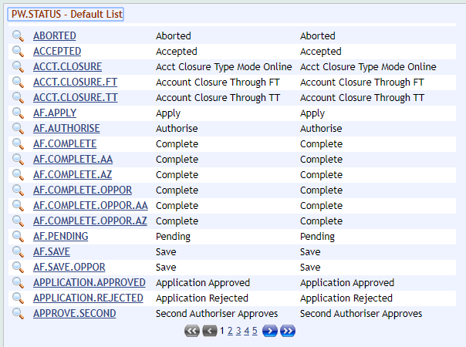
Process Workflow Components – PW.STATUS
Status codes are defined separately and attached to PW.ACTIVITY records
As an activity is worked on, that activity may go through a series of statuses. PW.STATUS is then also used to describe the status that the activity is in, at any one moment

Slide 14
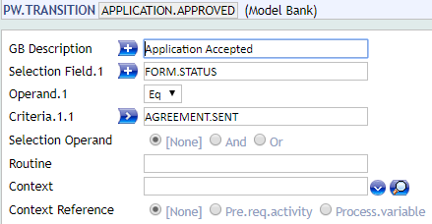
Process Workflow Components – PW.TRANSITION
PW.TRANSITION is the table used to define conditions/transition rules

Slide 15
Process Workflow Components – PW.TRANSITION
Transition rules are attached to activities via the PW.ACTIVITY or the PW.PROCESS.DEFINITION table
These rules determine when the status of an activity changes. The status further determines if and when a subsequent activity is launched, to appear on the TO.DO list or to automatically be presented to the user

Slide 16
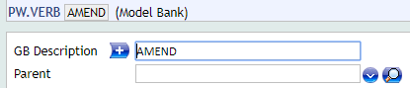
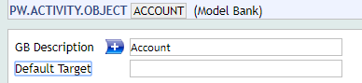
Process Workflow Components – PW.VERB and PW.ACTIVITY.OBJECT
Any activity can be considered as a verb and object: Create Customer, Amend Account, Close Account etc. Imposing a verb/object structure on the activity maintains a structure to Activities
Therefore, all PW.ACTIVITY records are made up of <PW.VERB>.<PW.ACTIVITY.OBJECT>,
for example CREATE(verb).CORP.CUSTOMER(activity object)
As the activity must be made of VERB and ACTIVITY.OBJECT, both these records must be in place before the PW.ACTIVITY itself can be created

Slide 17
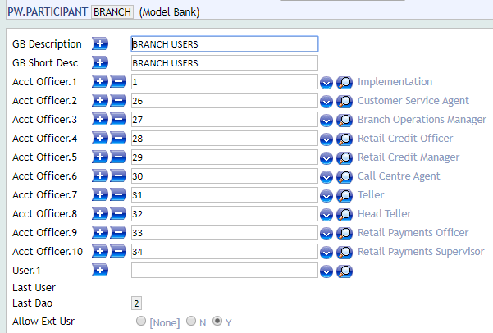
Process Workflow Components – PW.PARTICIPANT
PW.PARTICIPANT table is used to group Users or Account Officers together and is attached to either the PW.ACTIVITY or PW.PROCESS.DEFINITION record

Slide 18
Process Workflow Components – PW.PARTICIPANT
When an Activity is launched, a User/Account Officer is then automatically allocated to it
Any defined activity must be owned by a particular PW.PARTICIPANT group. Any process must be owned by a PW.PARTICIPANT group. Enquiry TO.DO also provides a drill down and launch their specific tasks

Slide 19
Process Workflow Components – Data Mapping
Data Mapping functionality in T24 ensures that it should not be necessary for the same information to be keyed in twice at any stage during a process - any relevant information from one activity can be mapped into any subsequent activity
The applications EB.FORMAT.ENTRY and EB.MAPPING.SOURCE enable the mapping of data from any preceding activity into any following activity. This can include the ability to manipulate data through concatenation of fields, using routines, universal local reference mapping and the mathematical operator’s addition, subtraction, multiplication, division
Note, this can include also mapping the @ID of an application

Slide 20
Process Workflow Components – Data Mapping
Steps to configure data mapping:
Identify the data that needs to be extracted and mapped (by the source data). This can either be sourced from a preceding activity, or from a ‘system variable’ (for example, today’s date, the USER’s id or the current company)
For each different preceding activity from which data will be mapped, an EB.FORMAT.ENTRY record will need to be created/identified. Within EB.FORMAT.ENTRY, the following points are defined:
What data will be extracted
Any transformations that will be done to the data
Where this data will then be placed

Slide 21
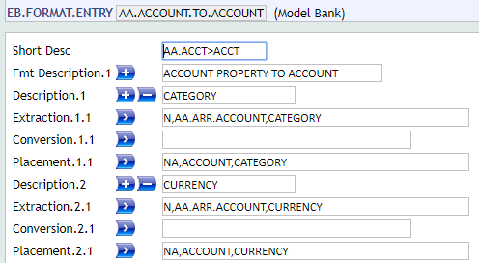
Process Workflow Components – EB.FORMAT.ENTRY
EB.FORMAT.ENTRY is a system wide utility for mapping data from one table to another
The table allows the EXTRACTION, CONVERSION and PLACEMENT of any data within T24
The EXTRACTION field defines what information is to be used
The CONVERSION field indicates what can be done with this information
The PLACEMENT field defines where the information is going to
Note, local reference fields should be used in exactly the same way as core fields - simply use the field name

Slide 22
Process Workflow Components – EB.MAPPING.SOURCE
For the overall mapping, an EB.MAPPING.SOURCE record must be created/identified. This record will identify:
Which EB.FORMAT.ENTRY records have been defined
Which activities the above EB.FORMAT.ENTRY records are using for their source data
‘Source data' comes principally from the transaction ref of a PW.ACTIVITY, but can also be provided from a routine

Slide 23
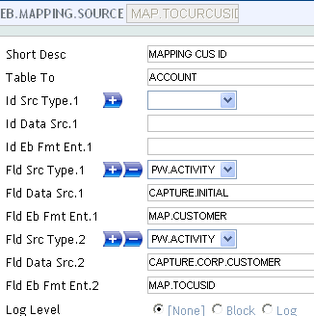
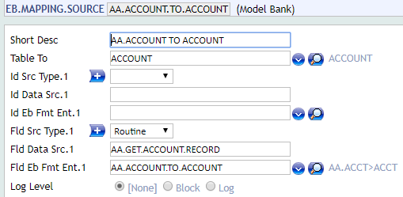
Process Workflow Components – EB.MAPPING.SOURCE
There are two sets of multi values on EB.MAPPING.SOURCE, the first set is used when mapping record ID, the second when mapping field data

Slide 24
Process Workflow Components – Data Mapping
Once the EB.FORMAT.ENTRY and EB.MAPPING.SOURCE records have been created, these can be placed on the PW.PROCESS.DEFINITION record

Slide 25
Process Workflow Components – PW.ACTIVITY
Each individual step in a process is described as a 'PW.ACTIVITY'. They are the separate actions, which the overall PW.PROCESS.DEFINITION links together to form the overall process
These records determine the duration, possible statuses, transition rules (which determine which status should be used), owner, along with the TARGET
The TARGET field defines which T24 application will be launched when the activity is executed; it details how the application will be run. The target should be an application, version or function. The application can either be a T24 application or an EB.TABLE.DEFINITION record

Slide 26
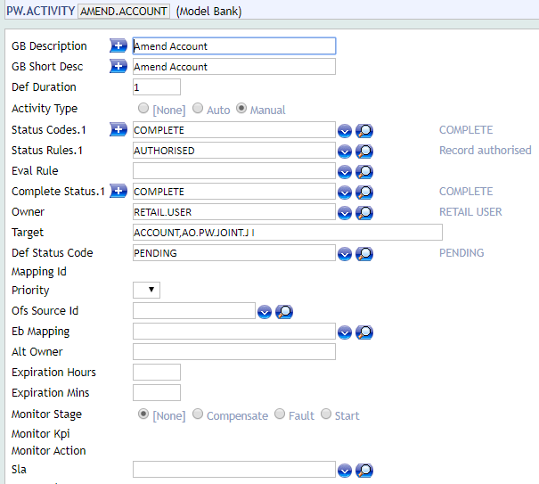
Process Workflow Components – PW.ACTIVITY

Slide 27
Process Workflow Components – PW.PROCESS.DEFINITION
The PW.PROCESS.DEFINITION application ties together all constituent parts of the Process Workflow module, to create a single process
This table allows the linking of Activities together in a logical business flow. It defines when an activity or spawned processes is enabled depending on pre-required Activities and their Statuses or Transition Rules. So PW.PROCESS.DEFINITION helps not only in defining the activities to be a part of the process, but the sequence and the stage at which they have to appear in the process
The PW.PROCESS.DEFINITION application can be divided into two sections:
the first handling which activities should be launched, when and how
the second section dealing with the overall process - what status it is in, and who is the owner of the overall process

Slide 28
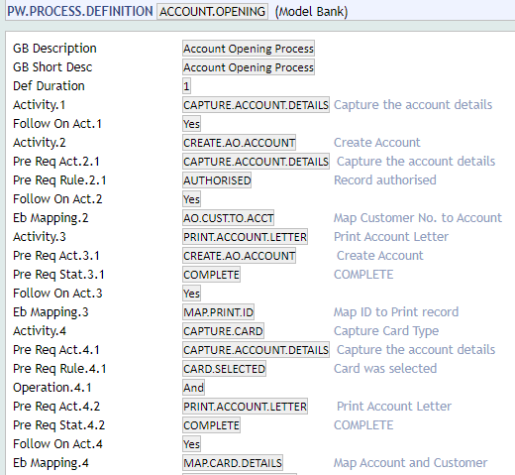
Process Workflow Components – PW.PROCESS.DEFINITION

Slide 29
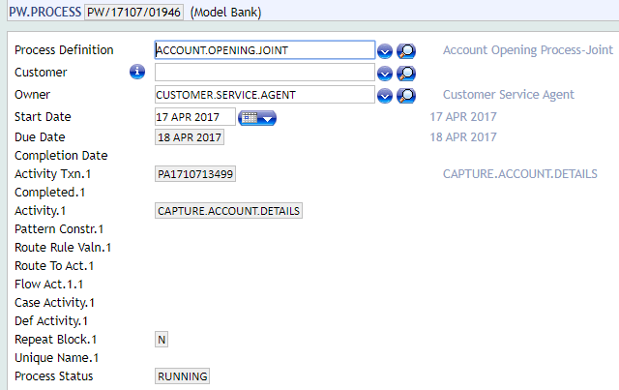
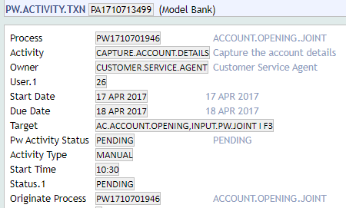
Process Workflow Deal Processing Overview
The underlying files managing a Process Workflow are PW.PROCESS and PW.ACTIVITY.TXN
Whenever a process is launched, a PW.PROCESS is created. Each activity that is triggered within that PW.PROCESS causes a PW.ACTIVITY.TXN record to be created

Slide 30
What is Pattern Based Workflow?
The PW module supports different pattern-based workflow apart from sequential workflow
The Pattern Based Workflow gives an exclusive choice pattern feature to the PW Process Engine
It provides the capability for a workflow to loop back or repeat an activity, execute more than one activity parallel, execute activity based on condition etc.
The Sequential flow of PW can be modified by using the various patterns available
Different patterns can be defined in PW.PROCESS.DEFINITION

Slide 31
Types of Patterns
Broadly classified into 2 Categories:
Iteration Patterns
Basic Control Patterns

Slide 32
Types of Patterns
Iteration Patterns:
Arbitrary Looping
Structured Looping
Recursion

Slide 33
Types of Patterns
Basic Control Patterns:
Sequence
Parallel Split
Synchronization
Switch Construct
Simple Merge

Slide 34
Iteration Patterns
The Iteration Patterns provide different types of capability to a process like re-execute a completed activity, repeat a single activity or a group of activities based on a condition
The sequential flow of process workflow can be modified using Iteration patterns
Applications involved in creation of Iteration Patterns:
PW.PARAMETER
PW.PROCESS.DEFINITION
PW.PROCESS
PROCESS.STATUS Enquiry
EB.API

Slide 35
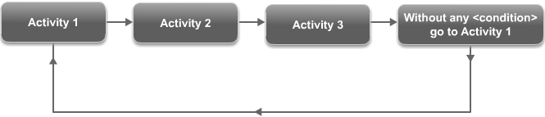
Arbitrary Looping
Arbitrary Looping is a very standard functionality in any workflow management which provides the ability to not only go forward and also to go backwards to any activity within the workflow
When the activity is routed back it could be any of the activities that have happened so far in that workflow

Slide 36
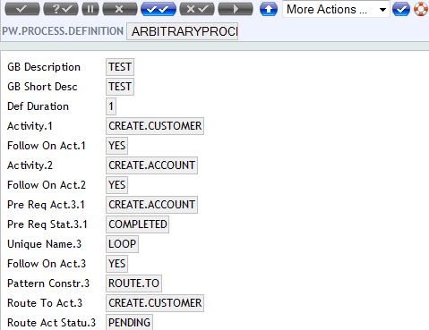
Example Process Definition for Arbitrary Looping

Slide 37
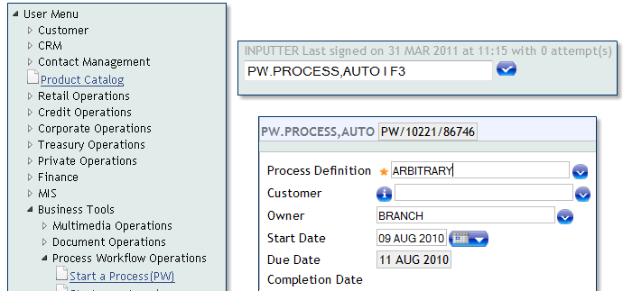
Execute the Workflow
PW.PROCESS is used for executing the defined process workflow
Executing PW.PROCESS is possible through Menu and Command Line

Slide 38
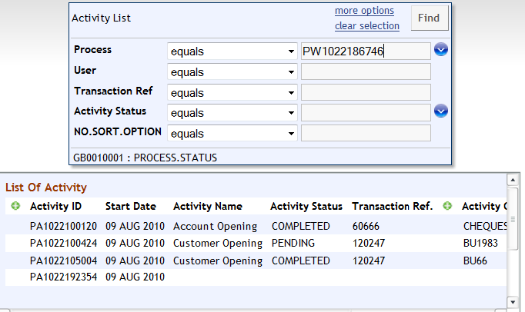
Execute the Workflow

Slide 39
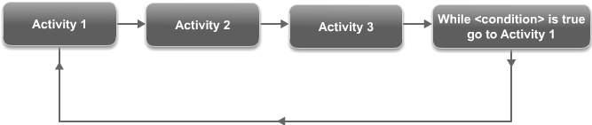
Structured Looping
Structured Looping (Repeat Variant) is used to loop back to already executed activity based on condition, until the condition become false the system will loop back to the activity which is already completed and re-execute the activity:

Slide 40
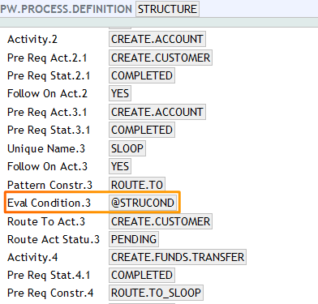
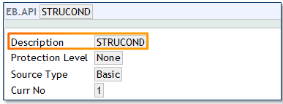
Example Process Definition for Structured Looping

Slide 41
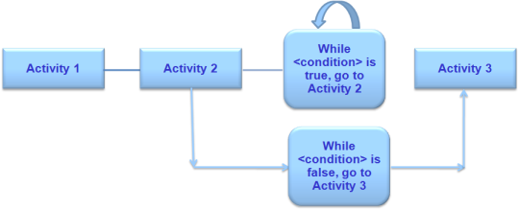
Recursion
The Recursive looping pattern allows an activity in a process to be executed recursively based on a condition. Each time the activity is repeated, the condition is evaluated and recursive loop continues till the result is TRUE. Once the result becomes FALSE, the loop stops and next activity gets triggered:

Slide 42
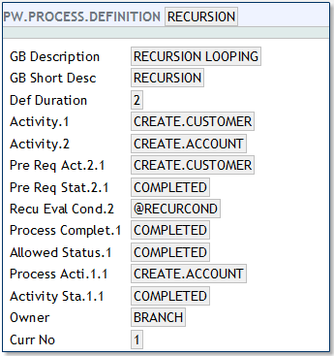
Sample Process Definition for Recursion

Slide 43
Basic Control Flow Patterns
Basic control flow patterns provide an exclusive choice feature to the PW Process Engine. With this feature in place, the process will able to route to a specific branch, execute two or more parallel activities etc.
Types of basic control flow patterns:
Sequence
Parallel Split
Synchronization
Switch Construct
Simple Merge

Slide 44
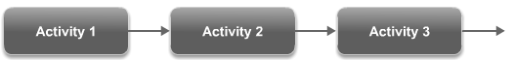
Sequence
An activity in a process is enabled after the completion of a preceding activity in the same process. This is the basic feature of process workflow
All the activities defined in the process will execute in sequence. This is the default pattern for a process:

Slide 45
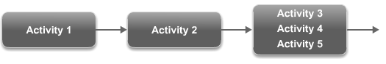
Parallel Split
Parallel Split is one of the patterns available in PW engine, which execute more than one activity parallel
The parallel activities can be defined using a single activity definition instead of creating separate definition for each activity in PW.PROCESS.DEFINITION
At the time of execution all the activities marked as parallel will trigger simultaneously with the option of choosing any activity:

Slide 46
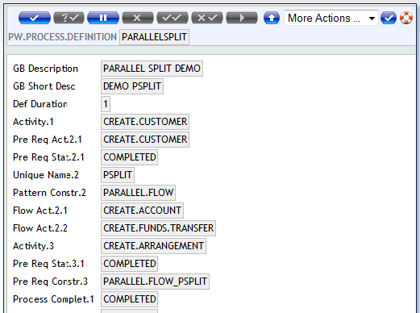
Parallel Split

Slide 47
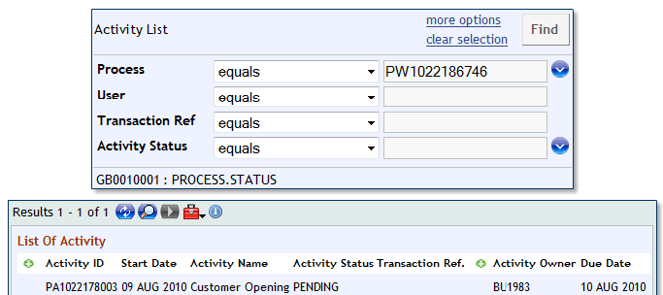
Executing Parallel Split Activities
Once the activity is initiated using PW.PROCESS it will not trigger the activity for execution, the activity need to be executed manually using the enquiries
PROCESS.STATUS enquiry will display the list of activities with its status and transaction ID for a particular process. Using the link available the activity can be executed

Slide 48
Synchronization
The basic behavior of a process is executing the activities in a sequence
If the process is created with Parallel Split pattern then the sequential flow of executing the activity is not possible, being more than one activity will trigger parallel
In such case Synchronization pattern will allow the next activity in the sequence to trigger only if all the activities marked as parallel are complete

Slide 49
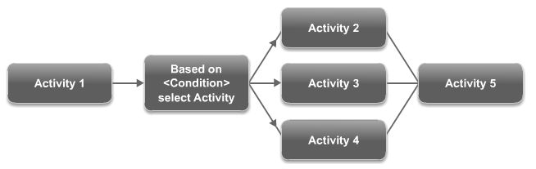
Switch Construct
Switch Construct pattern allow the process route to any activity from the given list based on a condition
At the time of execution, the process will trigger any one of the activity based on the value returned by the conditional routine:

Slide 50
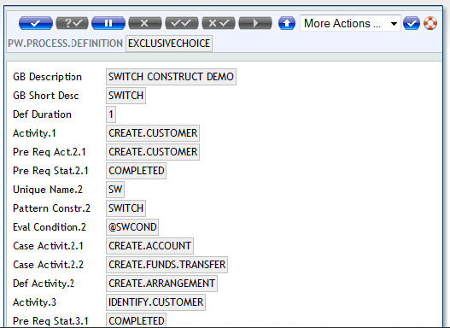
Switch Construct

Slide 51
Simple Merge
In Switch Construct, if an activity is defined after the construct, then the Simple Merge pattern will provide the way to initiate the activity based on the status of any of the Switch Construct activity which is executed

Slide 52
Concept of Process Variables
Process Workflow supports the concept of Process Variables which can be used in different stages of the process to govern the process flow logic
The following three fields are introduced in PW.PROCESS.DEFINITION table through which variables can be defined:
PROCESS.VAR.NAME
PROCESS.VAR.VALUE
PROCESS.VAR.TYPE

Slide 53
PW Enquiries
There are two principle ways in which activities may be presented to a user:
Through Auto Screen Creation where the user who caused the activity to be launched, is also within the team that can action that activity
By drilling down on an enquiry, which lists outstanding activities that require action
There are multiple enquiries incorporated into T24 Model Bank, to assist the workflows of specific roles and departments. Two basic, principle enquiries, upon which the others are based:
PROCESS.STATUS - which gives a view of the overall process
TO.DO - which lists the activities within the process, for direct action

Slide 54
PW in a Nutshell
Enhanced data mapping facilities
Re-usability of activities
Activities in a process can be automated
Allows user-defined enquiries to be created
End-user interface is an enquiry – user friendly
Can create user-defined applications
Past activities can be re-visited (using different PW Patterns)

Slide 55
Disadvantages of PW
The PW module itself has NO business logic built in
Does not generate warning or override messages if processes are left incomplete

Slide 56
Thank you for your time and attention!
FORANX LLC
Legal address:
35A, Ponomarenko str., 201 office, Minsk, 220015, Belarus
Tel.:+ 375 17 202 76 78
+ 375 17 202 76 79
Fax: + 375 17 362 34 22
Web-site: www.foranx.by
Minsk, 2021

